Slide 1


Seminar on “STARLINK INTERNET ”
Name :- Abhishek Kishor Gandre
Roll No. :- 07
Guide Name : - Prof. Nachiket Rathod
Department of Computer and Science Engineering
Shree Hanuman Vyayam Prasarak Mandal’s College of Engineering & Technology, Amravati. Sant Gadge Baba Amravati University, Amravati. Year 2021-2022

Slide 2
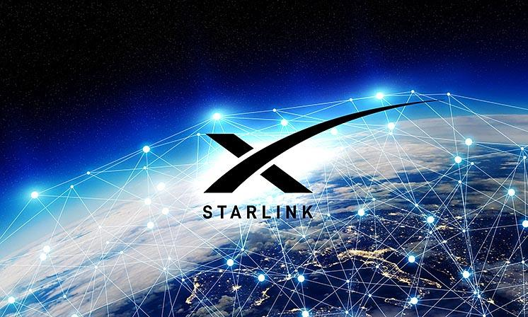
WHAT IS STARLINK
Thousand of satellite will make up a network called as Starlink.
Each satellite in this Elon Musk’s Starlink project weight just 260 kg.
Space-X will fix its satellite in lower earth orbit to provide faster internet speed.

Slide 3
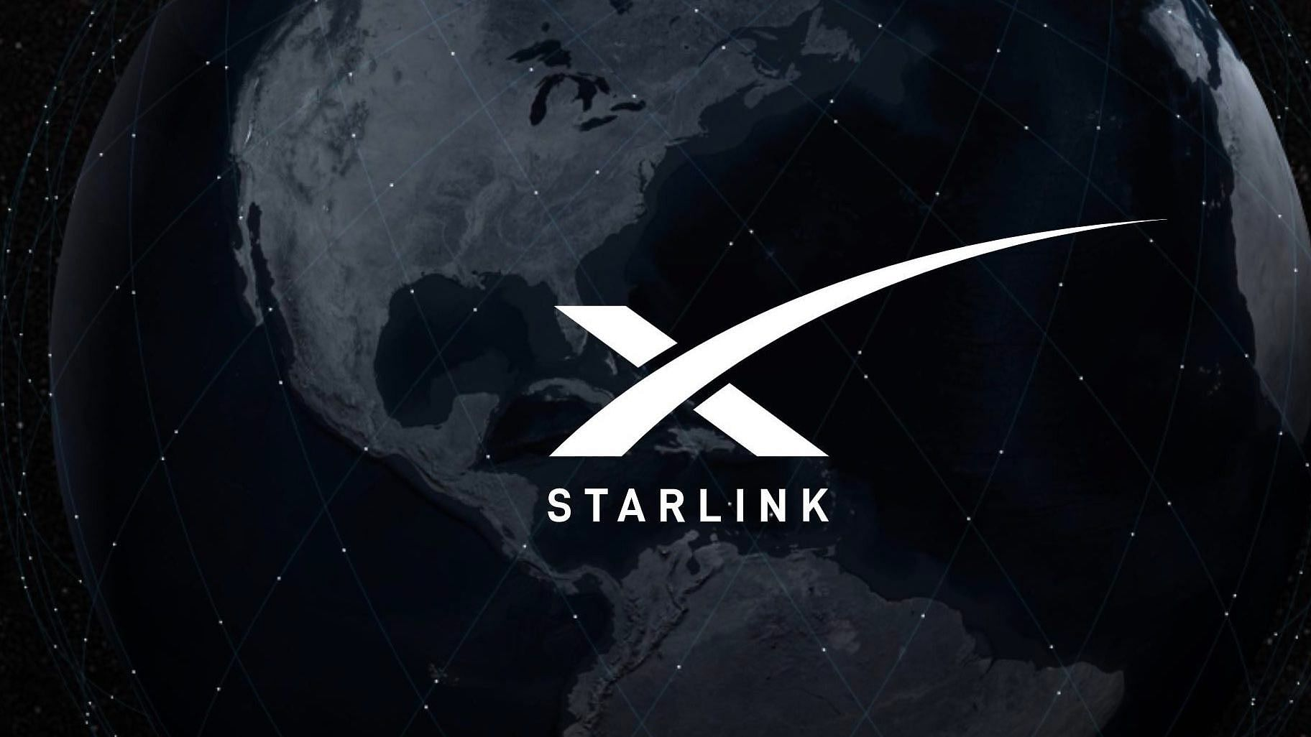


Slide 4
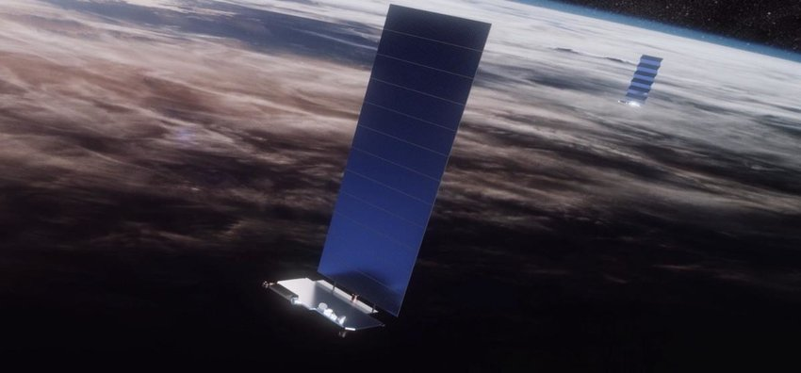
HOW THE SATELITE WORK
When these satellite put in earth orbit ,a single large solar array comes out to the power of satellite.
The main portion included four powerful antenna's for internet transmission .
They also have a laser that connect each satellite with four other in orbit.

Slide 5
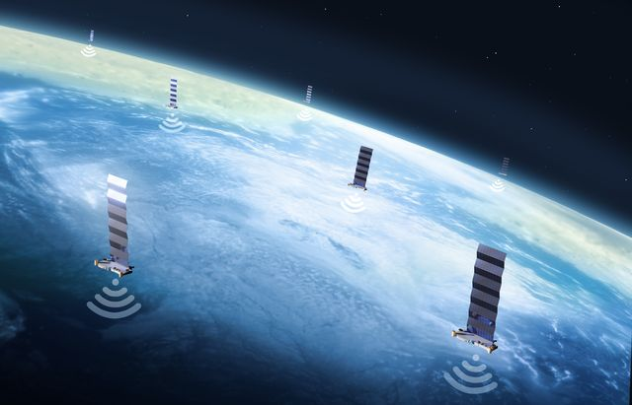
HOW THESE SATELLITE STAY NEAR EARTH
They include iontruster that use krypton gas . This allow them to stay in orbit longer even at this lower distance from earth.

Slide 6
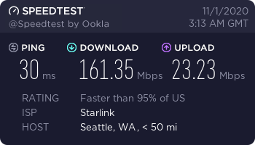
HOW THEY ARE PROVIDE FASTER INTERNET SPEED
Starlink satellite are in low earth orbit. Which are much closer than satellite provider generally use. This allow Starlink to deliver faster speed and lower lantany than you can usually get with satellite services.

Slide 7
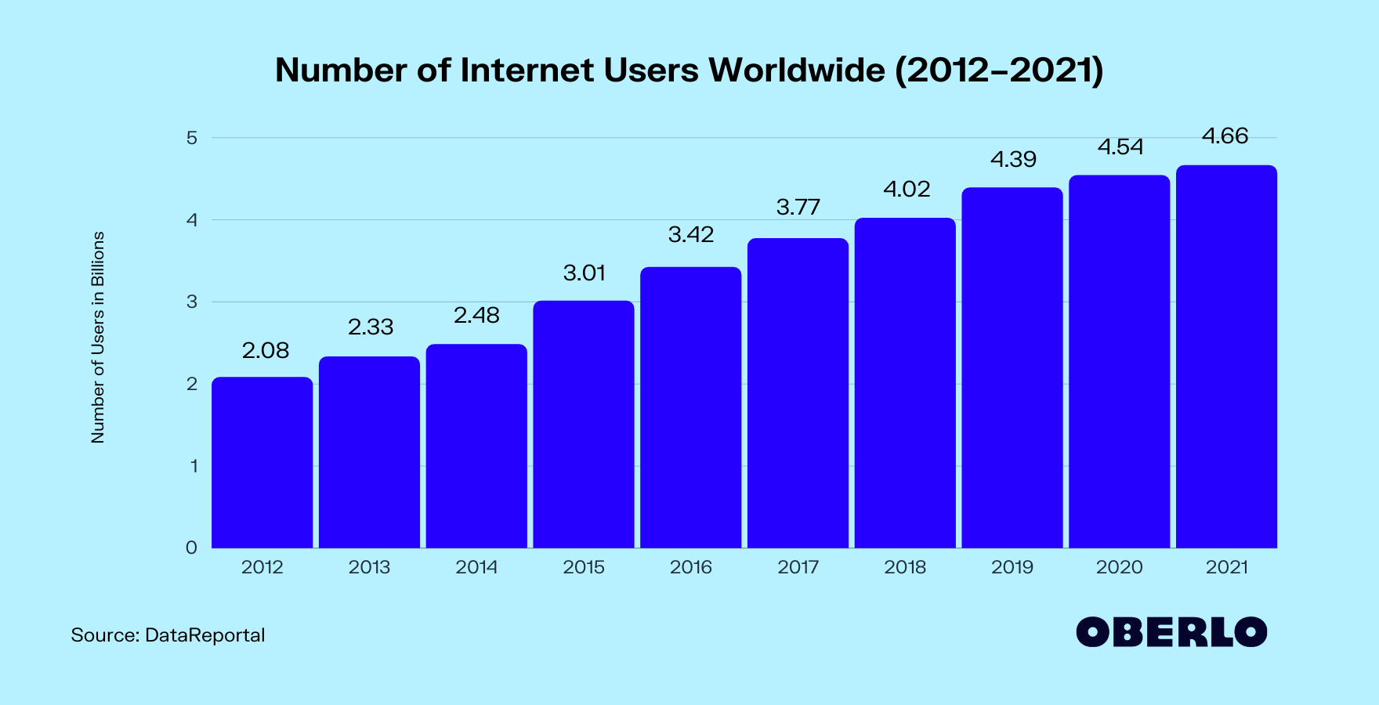
WHY IT IS CONSIDER AS A REVOLUTIONARY PROJECT
There is an increase in number of people using internet over the pass decades.
Despite the essential role the internet now plays across the globe ,it’s still out of reach to huge number of people worldwide including in the U.S.
Space-X’s Starlink Project seeks to bridge the “Digital Divide”

Slide 8

WHAT WILL BE THE PRICE OF THIS SERVICE AND HOW CAN USE IT
It will cost $499(36,815.52 rupees) for a one time cost for the ground hardware and $99 (7,304.8 rupees) a month for the actual internet services. By comparison, Hughes Net service cost as much as $150 a month, with 50gb high speed data plan.
We have to occupy a dish antenna like{Airtel , Dish Tv , Tatasky,etc} on which it will catch the signals of space-x satellite .

Slide 9
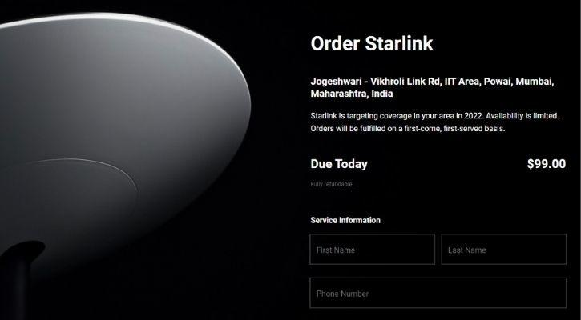
SCOPE FOR INDIA
Responding to a follower on Twitter about the launch of the services, musk’s said:”Yeah,should be fully mole later this year ,so you can move it anywhere or use it on an RV or truck in motion. We need a few more satellite launches to achieve complete coverage and some key software upgrades”
Space-X is cuurently offering the beta version of starlink on pre-orders in INDIA for a fully refundable deposite of $99(7,304.8 ruppes).

Slide 10
Advantages of the Starlink Satellite Internet
Airlines
Built-in WiFi is provided by quite a few airlines, some are free, some are paid, but none having good quality. As most of them use satellite internet, it is very slow and satellite internet, as of now, is very slow and costly. However, it will be revolutionary for Starlink airlines as their internet will not only be cheaper than traditional satellite internet but also faster.
Rural Areas
The internet of almost all rural areas is expensive, slow and unreliable. Considering the U.S, Maine, Vermont, Alaska, South Dakota, Idaho, Iowa, Montana, etc., are some of the places where the average download speed is less than 25 Mbps. With work-from-home culture becoming prevalent, Satellite internet provided by Starlink will give these places faster internet at cheaper rates.

Slide 11
At Sea
The only source of the internet at sea was satellites that are expensive and slow. Starlink’s low orbital satellite will not only provide fast internet but also offer a cheap price. Thus, cruise, cargo, or private ships will all enjoy the Internet, which was previously impossible to obtain.
Privacy
Since IP cannot be detected or states cannot access IP data of Starlink’s Satellite internet easily, there will be a more free media environment.

Slide 12
Disadvantages of the Starlink Satellite Internet
Not portable
Compared to the general cellular internet, Starlink is not portable. We can take our cell phones freely anywhere and receive the internet but obviously, the Starlink dish is not portable at all. Though there is a possibility of installing the dish over an RV or Boat, it is not compact enough to carry freely.
Slower internet in cities
Another major disadvantage for Starlink over cable internet is that at any given time, Starlink has a fixed number of satellites over a specific location and all the users in that particular spot are sharing the same bandwidth. So, in cities, the same bandwidth will be shared by many people as compared to rural areas. Thus, Starlink’s speed in cities will be slower compared to suburban areas.

Slide 13
Congestion in Space
The night sky could get cluttered by the 12,000 or so estimated satellites Starlink would be comprised of. Astronomers observing from the ground will be posed with interferences due to the satellites orbiting around the Earth. European Space Agency (ESA) published a study on March 3rd, last year, found that an uptick in satellites such as that of Starlink would affect wide range telescopes the most. Despite this, according to Bander Snatch, SpaceX CEO Elon Musk has assured that Starlink satellites “will dim as they move into their final orbit and will become a lot less visible.” We will get to know in time if the trade-off between global connectivity and a pristine night sky is worth it.

Slide 14
References
About Starlink , https://en.wikipedia.org/wiki/Starlink
For images using google search, https://www.google.com/webhp
Pros and cons , https://technosports.co.in/2021/04/03/what-is-starlink-its-details-advantages-disadvantages-in-2021/

Slide 15


